Slide 1

NYC Taxi Fare Predictions
Team 14: John Burns, Kayleigh Gillis, Ian Lawson, Sian Liu

Slide 2
Objective
Use Machine Learning to predict the fare amounts for a taxi ride in NYC given pickup and dropoff locations
Minimize the RMSE
Submission in the form of key, fare amount

Slide 3
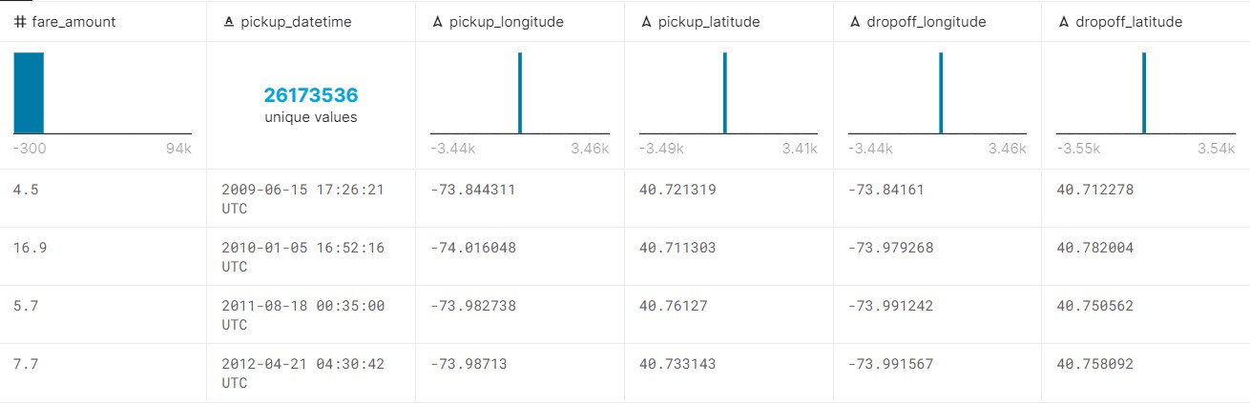
Key Features

Slide 4
Example 1
train = train %>%
filter(fare_amount>=2.5,
pickup_latitude<=41.71, pickup_latitude>=40.57,
dropoff_latitude<=41.70, dropoff_latitude>=40.57,
pickup_longitude<=-72.99, pickup_longitude>=-74.25,
dropoff_longitude<=-72.99, dropoff_longitude>=-74.26)
Notes:
# Deleting rows where the fare was below $2.50 makes a lot of sense as these are clearly outliers and will have detrimental effects on the rest of the model.

Slide 5
Example 1 (cont)
minkowski_distance <- function(x1, x2, y1, y2, p) {
return ((abs(x2 - x1)^p) + (abs(y2 - y1))^p)^(1 / p)
}
Notes:
# Calculating the Minkowski Distance, which apparently is a generalization of both the Manhattan and Euclidean distances

Slide 6
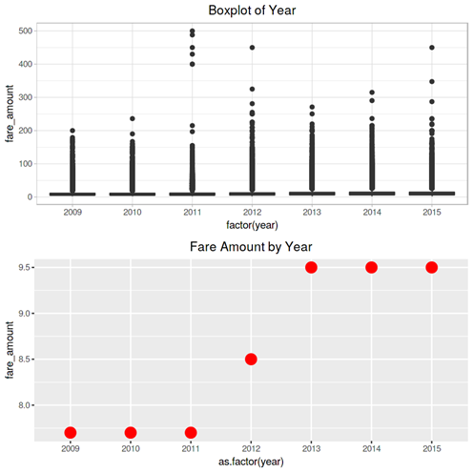
Notes:
# Really liked the approach of breaking down each predictor variable and investigating them separately before modelling. Created some combination of box plots or average plots of the variables to identify trends and distributions.
# For example, uncover that fares are increasing steadily over time – time component is significant
# Did similar plots for month, day of the week, and time of day to uncover cyclicality
# Also found that passenger count does not have a significant relationship with fare, though this should not be surprising
# Final model used Gradiant Boosting Machine (GBM), then picked the best model.

Slide 7
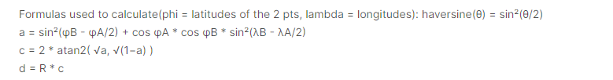
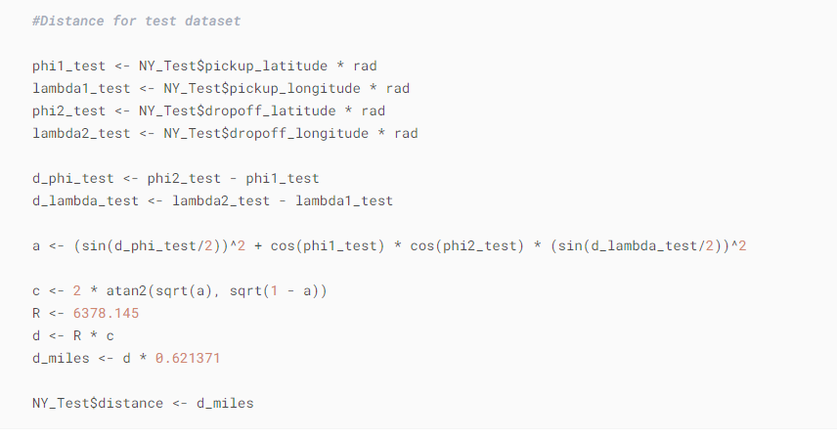
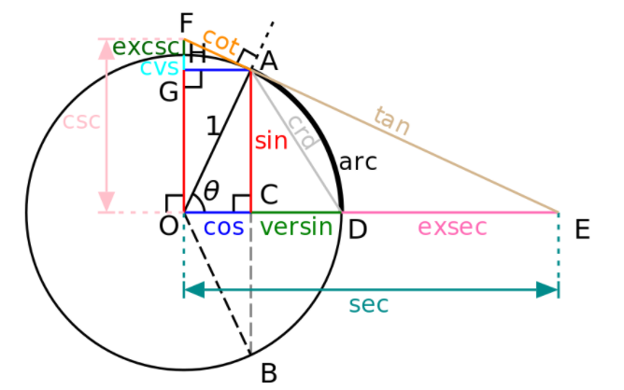
Example 2 NYC Taxi Fare Pred - EDA+GLM +Random Forest
Haversine distance
Notes:
total distance travelled on the spehere using the haversine distance/ great circle distance

Slide 8
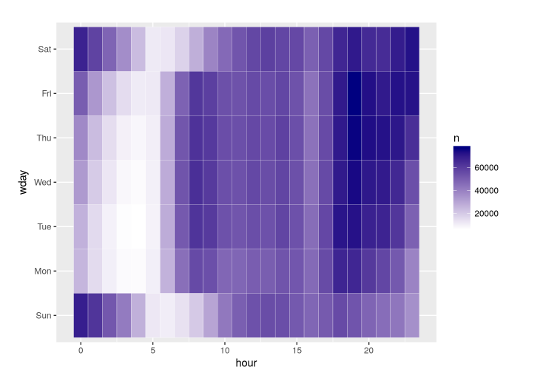
Example 2 NYC Taxi Fare Pred - EDA+GLM +Random Forest
Heatmap
Notes:
Weekday vs hour Heatmap

Slide 9
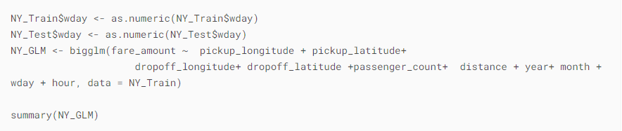
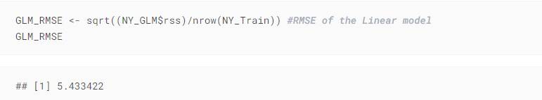
Example 2
Generalised Linear Model
Notes:
used the Bigglm function that uses variable^2 memory to create a generalised linear model instead of LM

Slide 10
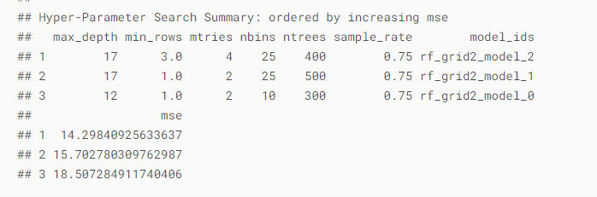
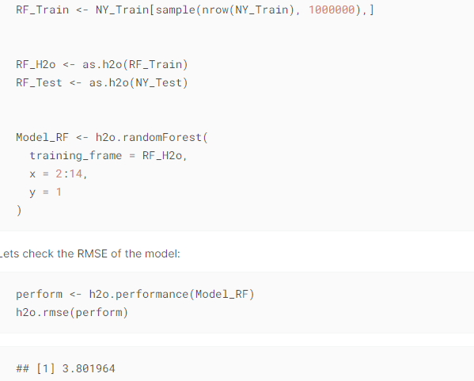
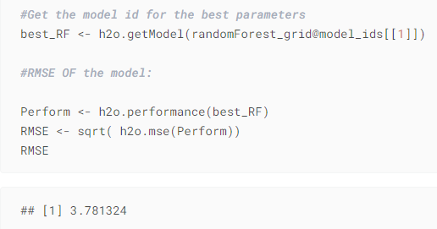
Example 2 NYC Taxi Fare Pred - EDA+GLM +Random Forest
Random Forest using H2o.ai and Grid Search
Notes:
using H2o.ai to create a Random Forest model with the best parameters choosing by Grid Search which return the best model.

Slide 11
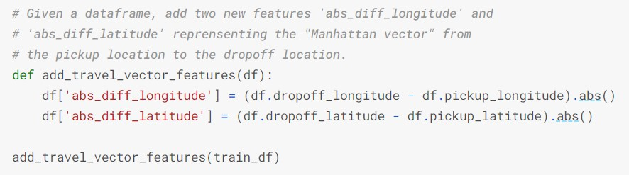
Example 3 NYC Taxi Fare Starter Kernel - Simple Linear Model
Notes:
Used Python instead of R, good to look at solving the same problem in different languages. Manhattan distance, which is the sum of absolute differences, and a simpler example compared to the first two
ex: given two points (x1, y1) and (x2, y2)
manhattan distance = |x1 - x2| + |y1 - y2|

Slide 12
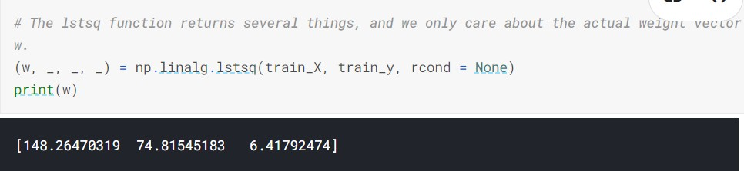
Example 3 NYC Taxi Fare Starter Kernel - Simple Linear Model
Notes:
After constructing the X and y training matrices, they used the lstq function to return the least squares solution to the linear matrix equation

Slide 13
Our Solution

Slide 14
Reproducibility
Explanation of data cleansing and training/testing splits included in R markdown
Commands in code to produce results
Experiment description given and parameters explained

Slide 15
Critique Links
Example1: https://www.kaggle.com/pyy0715/nyc-taxi-fare-prediction
Example2: https://www.kaggle.com/richashah1904/nyc-fare-pred-eda-random-forest-grid-search
Example3: https://www.kaggle.com/sudhirmundhra/nyc-taxi-fare-starter-kernel-simple-linear-model

